Slide 1
Hygge
A website for chilling

Slide 2
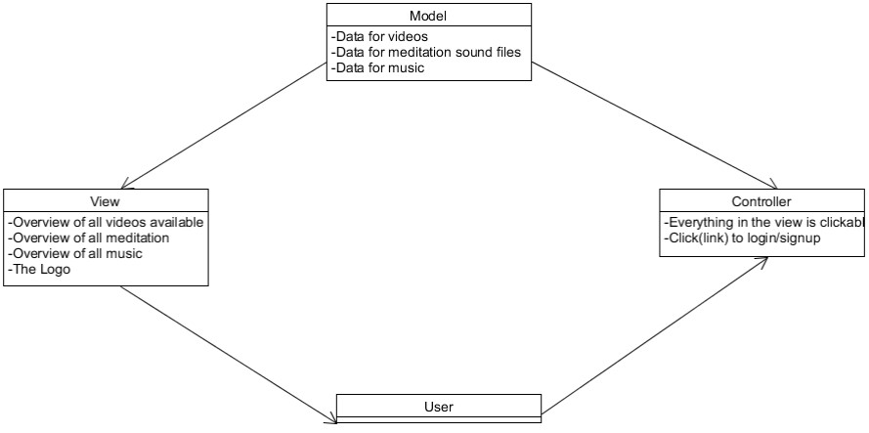
Project blurb & MVC Architecture
A website for students by students, made specifically to relax.

Slide 3
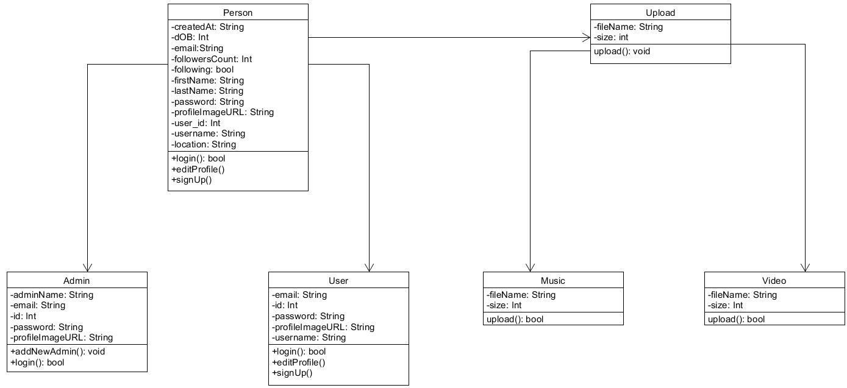
Domain Driven Design & UML Diagrams
Class Diagram

Slide 4
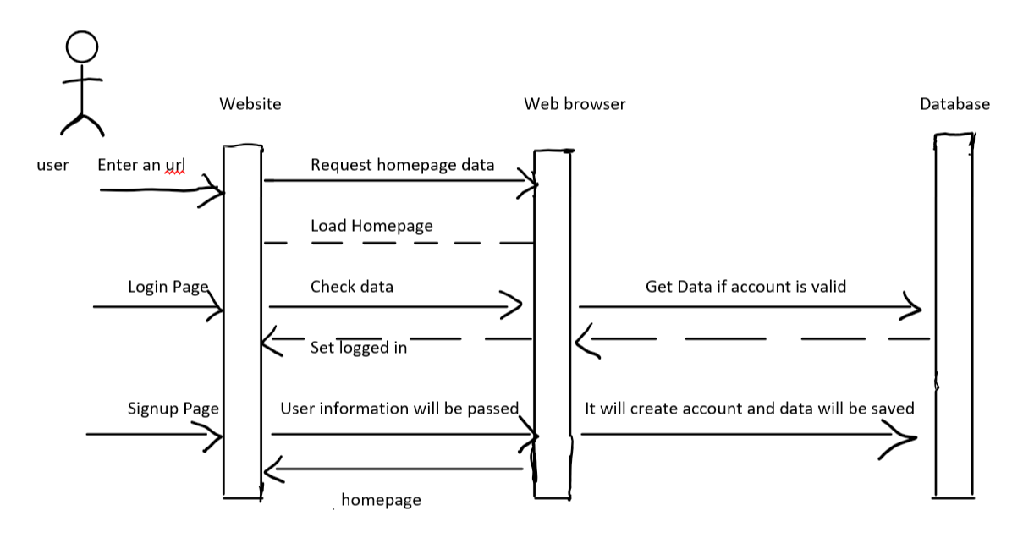
Sequence Diagram

Slide 5
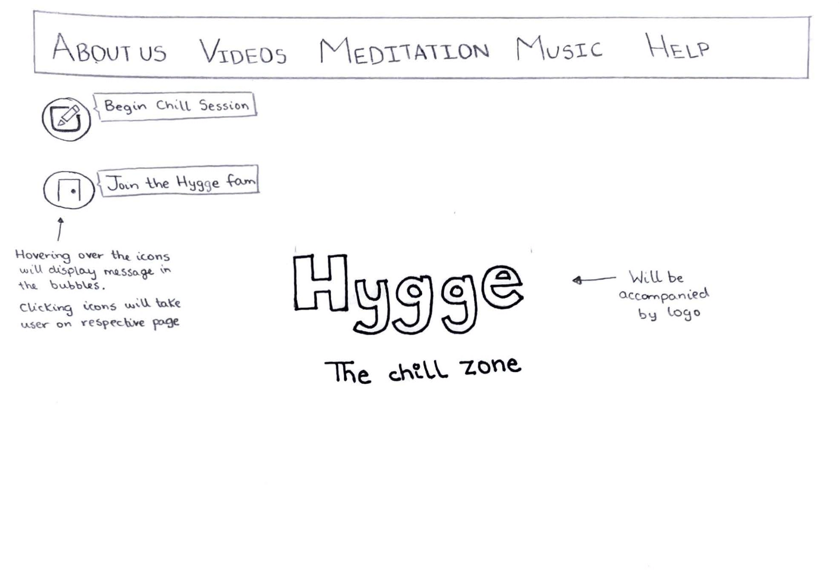
Lo-fidelity Prototype
Simple, clean look for website
As clutter free as possible
White & Black with pops of pastel

Slide 6
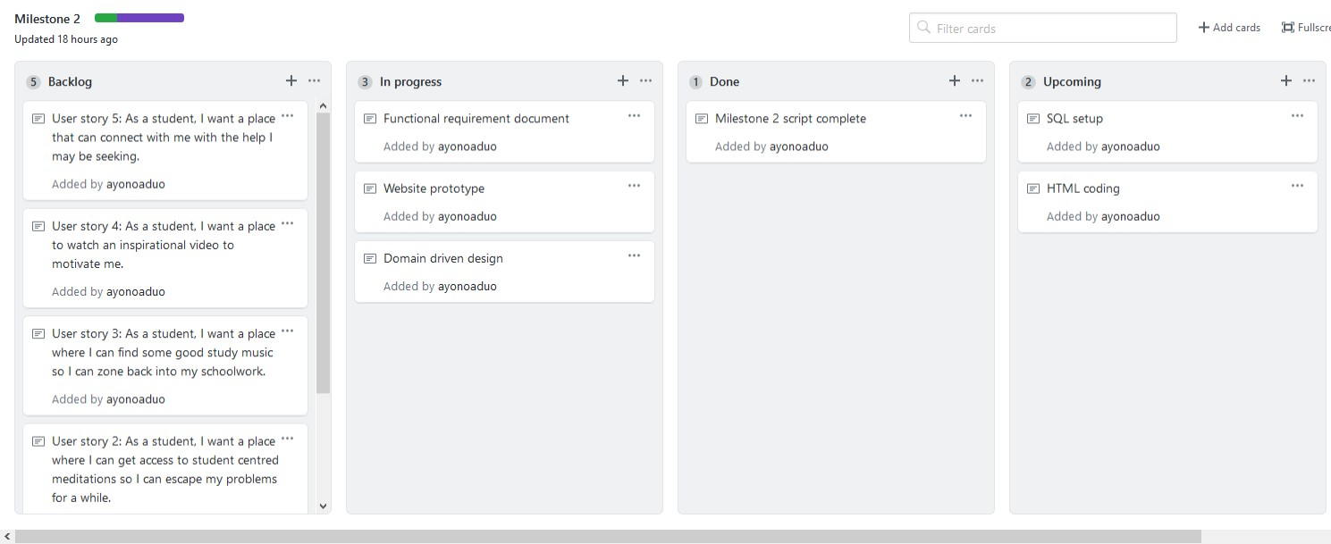
Requirements & Kanban
Created and updated our FRD

Slide 7
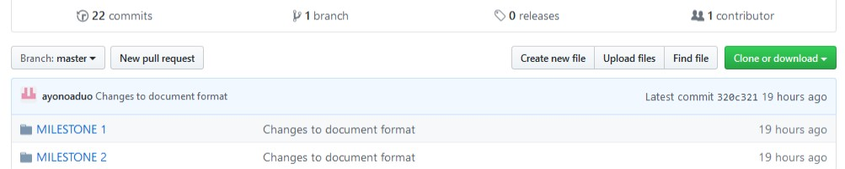

Github
Our github file structure was updated
Easier to understand

Slide 8
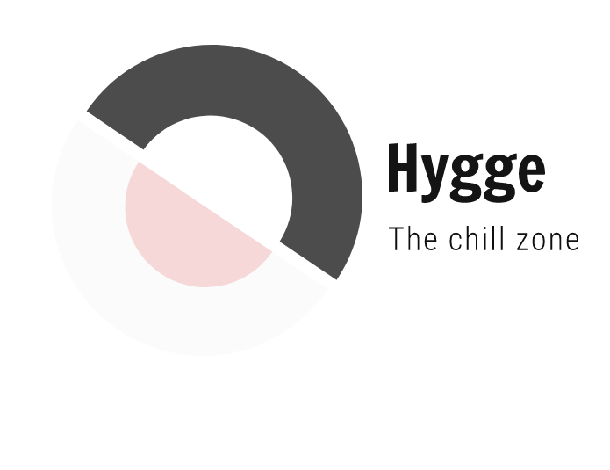
Miscellaneous
We decided on the following logo for our project

Slide 9

Group Reflection
Lofi prototype was a great way to map out website’s interface
Functional requirements document
Everyone must pull their weight
Be understanding of everyone’s situations
Need more clarity and examples on diagrams/functional requirements

